Slide 1






Health Connect
Seamless Healthcare Access And Cancer,
Heart Disease Prediction

Slide 2




Problem Statement
Inaccessible Medical records
1. Online Reports Accessibility
2. Beds Alloted Problem
3. Online Doctor Appointment
Rise In Cancer, Heart Disease
Emergency Treatment Delays
Rural HealthCare Access

Slide 3






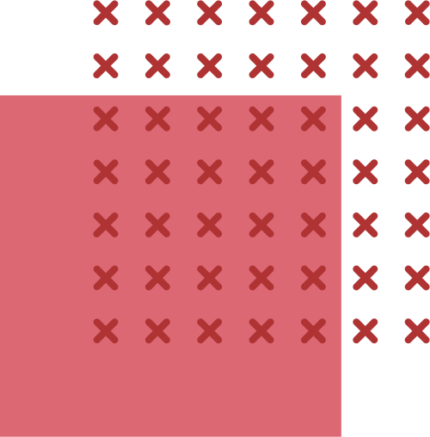
HealthConnect Website Features
Hospital Section
Pre Cancer Prediction
Heart Disease Prediction
Contact/Query Section

Slide 4








Hospital Section
Nurse -> Patient Registration
-> Book Appointment
-> Updates Beds Availability Data
Doctor -> Create Report
-> Book Appointment
-> Updates Beds Availability Data
Admin -> Can Add Admin, Doctor, Nurse
-> Updates Beds Availability Data
-> Add Ambulance
-> Add Beds

Slide 5
Pre Cancer Prediction
The cancer like lung, prostrate, and colorectal cancers contribute up to 45% of cancer deaths.
So in this project we are using machine learning algorithms to predict the chances of getting cancer.
Algirithms Used:
1. Naive Bayes
2. decision tree
3. kNN
4. kMeans clustering
5. RandomForestClassifier

Slide 6
Heart Disease Prediction
World Health Organization has estimated 12 million deaths occur worldwide, every year due to Heart diseases.
Earlier research intends to pinpoint the most relevant/risk factors of heart disease as well as predict the overall risk using logistic regression.
The classification goal is to predict whether the patient has 10-year risk of future coronary heart disease (CHD).
We have implemented Logistic Regression Model to predict Coronary Heart Disease.

Slide 7
Contact/Query Section
We have integrated contact window for assistance to patients so that that they can get things done on basis of their need.
Patients will get a chance to interact with the doctors and get personalized assistance once their enquiry is accepted.
benefits they’ll get:
1. Online assistance
and also they can meet with the doctors inreal time
2. Full Security for their data

Slide 8


Thankyou!

